Slide 1
N-Tier Architecture

Slide 2
Definition of N-Tier Architecture
N-tier architecture is also called multi-tier architecture because the software is engineered to have the processing, data management, and presentation functions physically and logically separated. That means that these different functions are hosted on several machines or clusters, ensuring that services are provided without resources being shared and, as such, these services are delivered at top capacity. The “N” in the name n-tier architecture refers to any number from 1
Not only does your software gain from being able to get services at the best possible rate, but it’s also easier to manage. This is because when you work on one section, the changes you make will not affect the other functions. And if there is a problem, you can easily pinpoint where it originates.

Slide 3
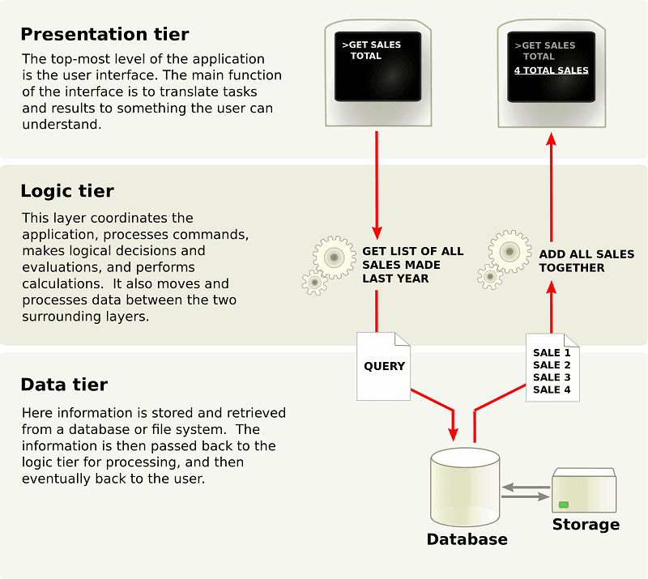
A More In-Depth Look at N-Tier Architecture
N-tier architecture would involve dividing an application into three different tiers. These would be the
logic tier,
the presentation tier, and
the data tier.

Slide 4
Contd.
The separate physical location of these tiers is what differentiates n-tier architecture from the model-view-controller framework that only separates presentation, logic, and data tiers in concept. N-tier architecture also differs from MVC framework in that the former has a middle layer or a logic tier, which facilitates all communications between the different tiers. When you use the MVC framework, the interaction that happens is triangular; instead of going through the logic tier, it is the control layer that accesses the model and view layers, while the model layer accesses the view layer. Additionally, the control layer makes a model using the requirements and then pushes that model into the view layer.
This is not to say that you can only use either the MVC framework or the n-tier architecture. There are a lot of software that brings together these two frameworks. For instance, you can use the n-tier architecture as the overall architecture, or use the MVC framework in the presentation tier.

Slide 5
What are the Benefits of N-Tier Architecture?
There are several benefits to using n-tier architecture for your software. These are scalability, ease of management, flexibility, and security.
Secure: You can secure each of the three tiers separately using different methods.
Easy to manage: You can manage each tier separately, adding or modifying each tier without affecting the other tiers.
Scalable: If you need to add more resources, you can do it per tier, without affecting the other tiers.
Flexible: Apart from isolated scalability, you can also expand each tier in any manner that your requirements dictate.

Slide 6
In short, with n-tier architecture, you can adopt new technologies and add more components without having to rewrite the entire application or redesigning your whole software, thus making it easier to scale or maintain. Meanwhile, in terms of security, you can store sensitive or confidential information in the logic tier, keeping it away from the presentation tier, thus making it more secure.

